Slide 1

Purchasing and Reimbursement Workshop
Elizabeth Jackson
Assistant to the Chair
11/29/23

Slide 2


Goal: Get you more familiar with purchasing and reimbursement processes among other topics
"No one can whistle a symphony. It takes a whole orchestra to play it." – H.E. Luccock
Notes:
I understand that the nature of this field is different from others. Because it requires going out into nature and taking samples and doing research, it requires new equipment and lots of travel. And so therefore, it requires knowing about purchasing and reimbursement and these other processes you wouldn’t normally think about. The back half of things. And staff’s job is to deal with these processes to support you. And so, really, to make sure everyone has what they need, you, us staff, make sure everything goes swimmingly, it’s teamwork. And so I wanted to include a quote about it.

Slide 3
Agenda
Purchasing
What is a Worktag?
Overview of purchasing process
Reviewing different vendors
UVA marketplace
OTS
Travel
Booking travel
Reimbursements
When appropriate?
Short demo in Workday?
Shipping
Fedex
International shipping and export controls

Slide 4
Purchasing

Slide 5
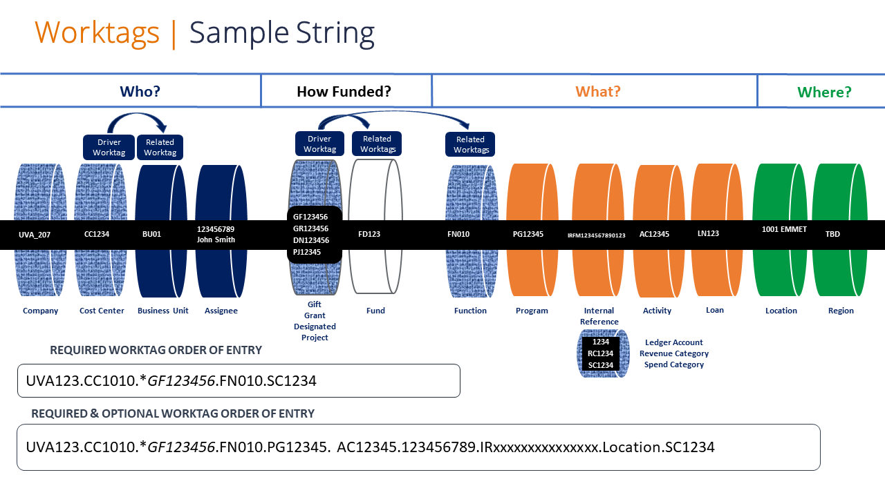
What is a worktag?
Notes:
Series of letters and numbers that categorizes and labels the many pots of funds UVA has. As you can see, it there’s different components to it. It labels who it belongs to, what its used for, what department its housed in, what kind of activity used for it, etc. Literally like a string. Don’t have to memorize it. When one of the staff and (hopefully) faculty give you a worktag, use all components of the worktag. Don’t leave anything out. Why? Because when fiscal staff run reports, it causes problems down the road with the funds applying properly and with running the reports, especially for non-grants. Grants are easier, but still.

Slide 6
Different vendors
Vendors who we have contracts with. Give us better pricing, exclusive services, perks, etc. Ex: Fischer Scientific
Contract vendors are in UVA marketplace
Contract Vendor
Vendor who is registered in UVA’s payment system so they can get paid for their goods/services. We don’t have contracts with them.
Contract vendors are NOT in UVA marketplace. Use OTS to request items.
Registered Vendor
Notes:
The purchasing guidelines we updated has a list of commonly used vendors by the department.

Slide 7
SWAM Vendors
SWAM: Small, Minority, and women-owned business. Goes through vetting process by state. Specific criteria found here: https://sbsd.virginia.gov/certification-division/swam/
SWAM directory: https://directory.sbsd.virginia.gov/#/executiveExport

Slide 8
Basic Purchasing process in UVA marketplace
Submit order in Marketplace-get a requisition number
Automatic approval-get a PO
PO goes to vendor
Wait for approval
Approval *usually* received within 24-48 hours
Vendor ships product
Done either by Fedex or UPS usually
We receive product
You sign for product

Slide 9
Booking Travel & Reimbursements

Slide 10
Booking Travel-Quick recap
Have Dept (ShaRhonda) book travel
Book Travel yourself
Talk to your advisor ahead of time and get Worktag and budget
Work with ShaRhonda to get everything booked
Still check with PI and get approval before booking
Request reimbursement AFTER travel finished.
University will not cover credit card interest
Put reimbursement into Workday

Slide 11

When to do a reimbursement?
Totally fine.
Not ok.
After you finish traveling
For conferences or for field work
Can include emergency purchases for lab work or lab equipment while out in the field
We’ve been flexible on reimbursing sales tax in these circumstances
Purchasing supplies last minute, on your own, all the time.
Amazon.
Mileage from Clark Hall to the Oakhurst Inn.
Amazon.
Buying groceries, and then going out to eat.

Slide 12
Shipping & Export Controls

Slide 13
Fedex & Export Controls
When shipping internationally or exporting data internationally, it must go through export controls.
Export controls regulate the shipment or transfer of controlled items, technology, software, or services out of the U.S. Ties to the Export Control Act of 1976 and Export Admin Act of 1979. It’s basically to protect U.S economic and national security interests and support U.S foreign policy interests.
Before asking ShaRhonda to ship overseas, you and your advisor must contact the Office of Export Controls.
https://research.virginia.edu/research-security/export-controls

Slide 14
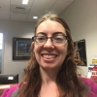

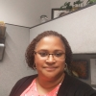
Staffing Changes as of 11/29/23
Things are in flux... Questions about who does what- ask Howie or one of us.
Elizabeth-Chair Assist
ShaRhonda- Admin FD
Laurie Hammond
VACANT-Department Manager
VACANT-Nongrant Fiscal Tech
Financial Aid
Academic milestones
Backup to ShaRhonda
Course scheduling
Fedex
Travel+
NEW ROLE- Purchase and reconcile for grants
Filling void of old role
DM in another Dept filling in temporarily for some things
Prasanna Anabathula doing some purchasing. Unsure of time left here

Slide 15

Thank you!

